Slide 1
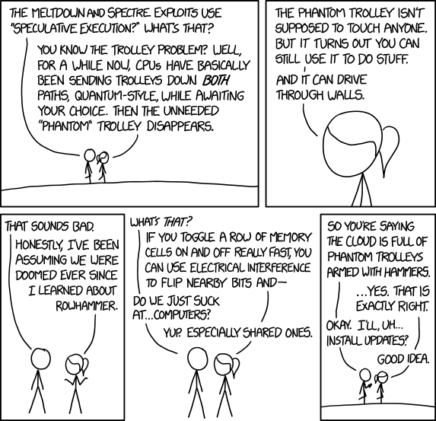
Mitigating Spectre and Meltdown in LLVM
https://xkcd.com/1938/

Slide 2
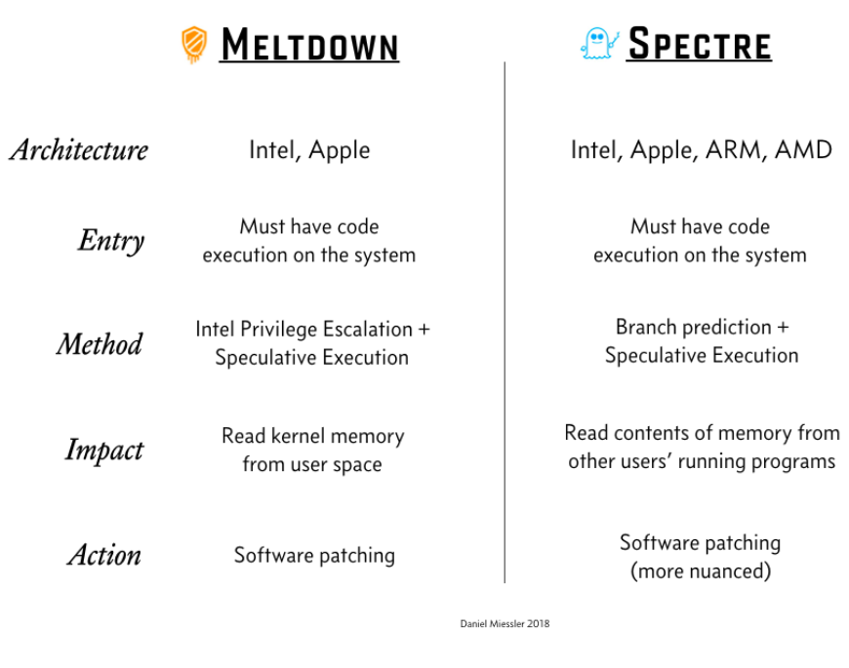
https://meltdownattack.com/
Notes:
Meltdown has already been fixed using os patches so we will mostly cover spectre and its defense in the following slides.

Slide 3
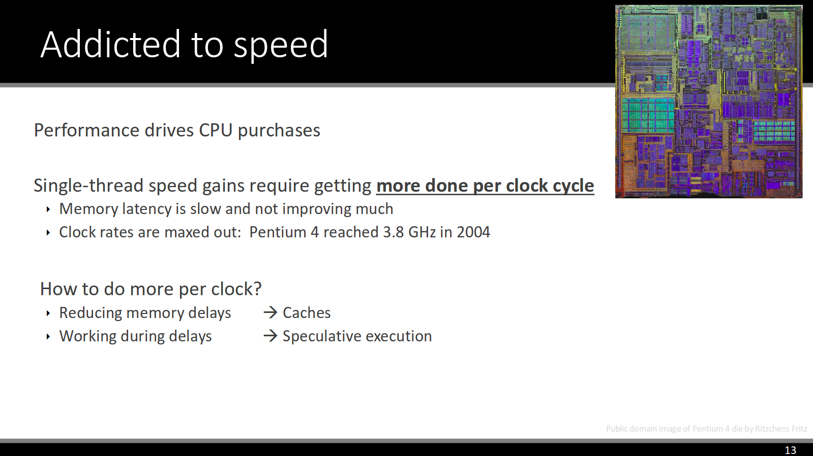
https://www.rsaconference.com/videos/spectre-attacks-exploiting-speculative-execution
Notes:
How and why did spectre happen?
Spectre is a feature that is working how it was supposed to be, it is not a bug.

Slide 4
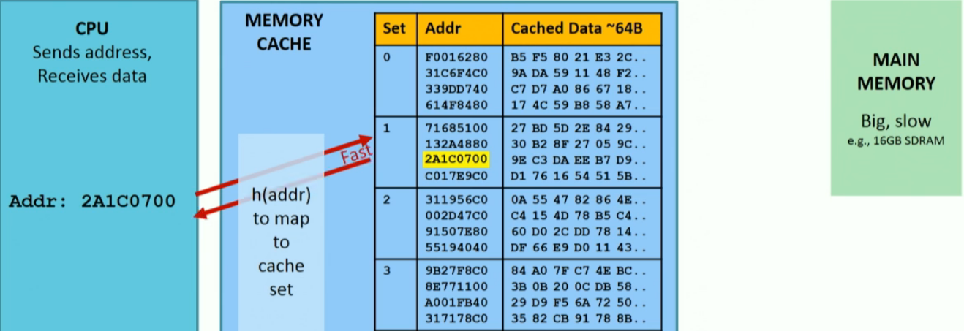
Accessing Memory in Cache
https://www.rsaconference.com/videos/spectre-attacks-exploiting-speculative-execution

Slide 5
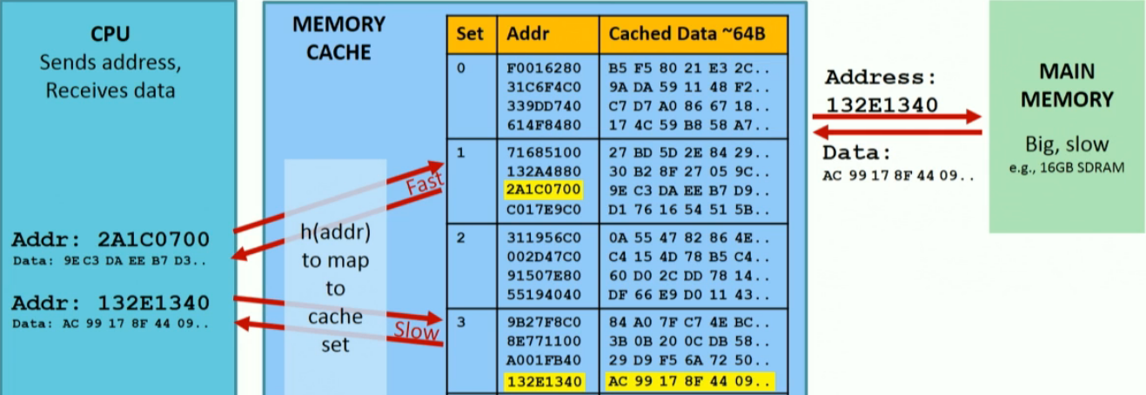
Accessing Memory Not in Cache
https://www.rsaconference.com/videos/spectre-attacks-exploiting-speculative-execution

Slide 6
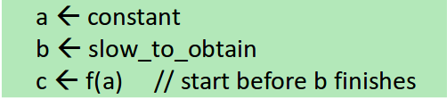

Out of Order Execution
Speculative Execution
https://www.rsaconference.com/videos/spectre-attacks-exploiting-speculative-execution
Notes:
Ooe is one of the techniques that is used to squeeze some more performance from the processor but speculative execution takes it even further

Slide 7
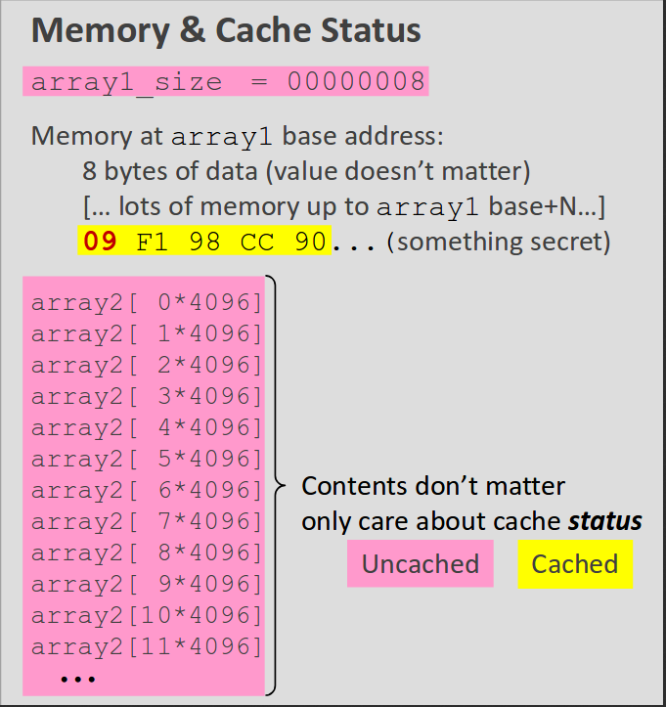

Spectre Attack Variant 1 Example
https://www.rsaconference.com/videos/spectre-attacks-exploiting-speculative-execution

Slide 8
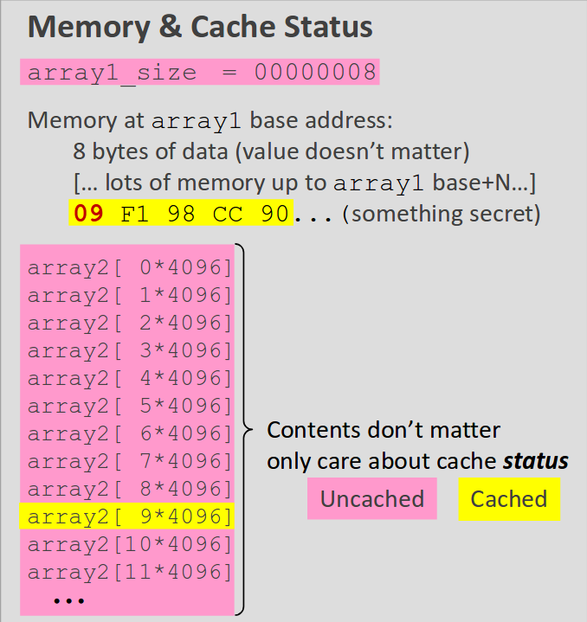
Spectre Attack Variant 1 Example
https://www.rsaconference.com/videos/spectre-attacks-exploiting-speculative-execution
Notes:
There is no direct isa to extract the information so a side channel attack is done.

Slide 9
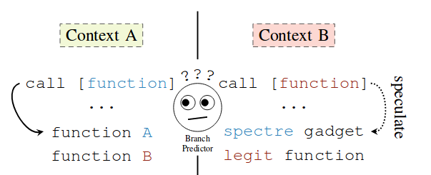
Spectre Attack Variant 2
Indirect branches are poisoned in this variant.
https://spectreattack.com/spectre.pdf

Slide 10
Challenges in Detecting Spectre
These standard techniques do not work.
Syntax Checking : Unable to detect which part is controlled by untrusted input.
Intra-Procedural Analysis: Spectre code patterns may span across multiple procedure boundaries.
State of the Art Software Testing: Not able to detect speculative execution.
More than program Semantics: Micro Architectural features are being exploited which cannot be detected here.
https://arxiv.org/pdf/1807.05843.pdf

Slide 11
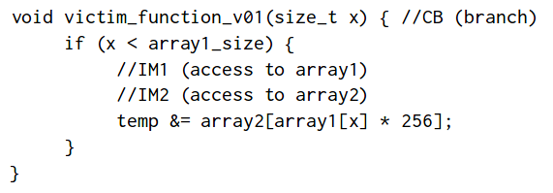
oo7: Low-overhead Defense against Spectre Attacks via Binary Analysis
https://arxiv.org/pdf/1807.05843.pdf

Slide 12
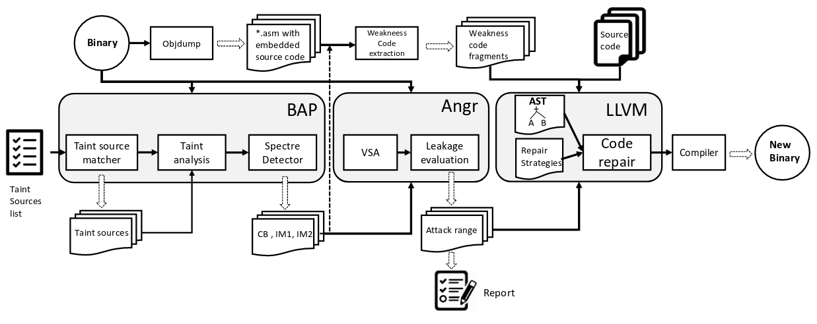
oo7 Pipeline Overview
https://arxiv.org/pdf/1807.05843.pdf

Slide 13
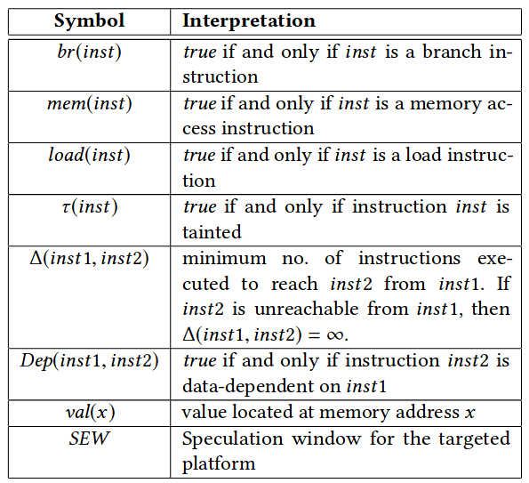
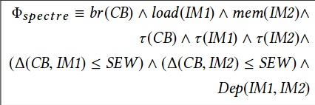
Detecting Vulnerability in Binary
https://arxiv.org/pdf/1807.05843.pdf

Slide 14

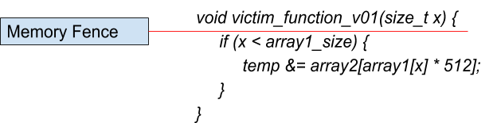
Code Repair
Three ways are suggested in the Paper for it:
Inserting Memory Fence
https://arxiv.org/pdf/1807.05843.pdf

Slide 15
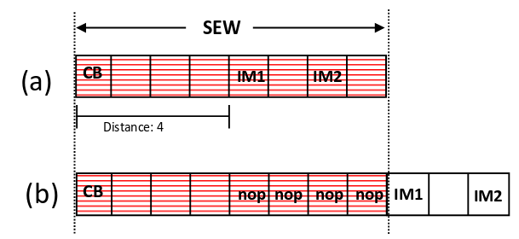
Code Repair
2) Inserting NOP Instructions
In general, for each detected CB,we insert SEW−∆(CB,IM1) number of NOP instructions to fix the respective Spectre vulnerability.
https://arxiv.org/pdf/1807.05843.pdf

Slide 16
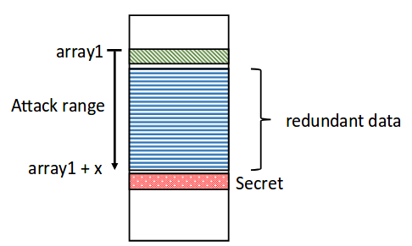
Code Repair
3) Padding Redundant Data
https://arxiv.org/pdf/1807.05843.pdf

Slide 17
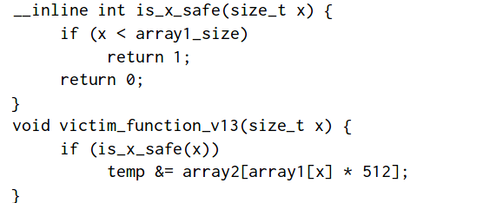
Escaping oo7
This is a special case, as the return value is not data-dependent on x.Instead, the return value is manipulated via the control dependency on x.
https://arxiv.org/pdf/1807.05843.pdf

Slide 18
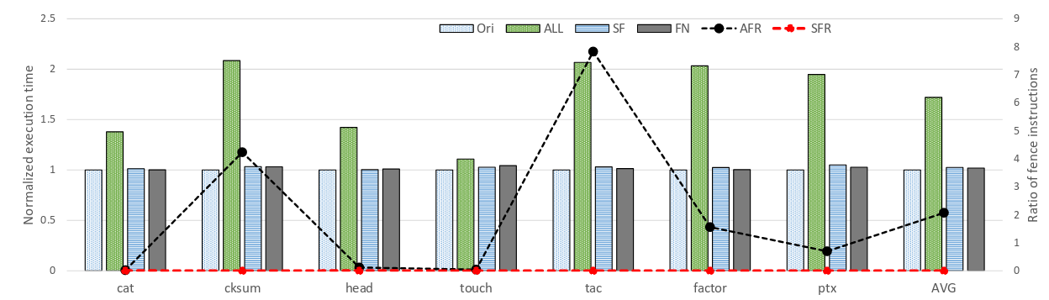
Effect on Performance
https://arxiv.org/pdf/1807.05843.pdf

Slide 19
Possible Plan of Action
Go through x86 ISA to get a better understanding of where and why oo7 fails.
Trying to find similar paradigm in LLVM IR as discussed in the oo7 paper for binary analysis.
Having a look at Machine level IR in LLVM.
Implementing Taint Analysis Pass in LLVM.

Slide 20
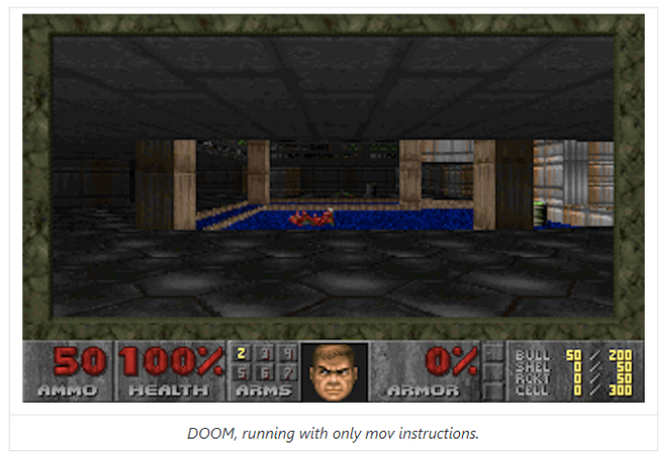
Irrelevant Awesome Stuff
Compiler that only outputs mov instruction in x86.
Able to compile an entire game DOOM which outputs 1 frame every 7 hours.
https://github.com/xoreaxeaxeax/movfuscator/tree/master/validation/doom

